Slide 1
Data Streaming in a Real World Application
Gustavo Almeida – May, 2020

Slide 2
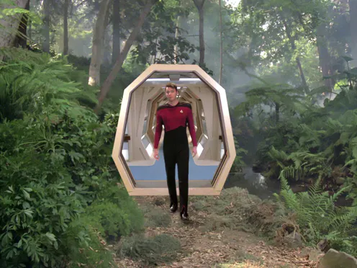
Holodeck – concept
“The Holodeck is a fictional device from the television franchise Star Trek. It is referred to as a holosuite in the series Star Trek: Deep Space Nine. It is a stage where participants may engage with different virtual reality environments. From a storytelling point of view, it permits the introduction of a wide variety of locations and characters, such as events and persons in the Earth's past and imaginary places or beings, that would otherwise require complicated set-ups such as time-travel or dream sequences. Writers often use it as a way to pose philosophical questions.”
https://en.wikipedia.org/wiki/Holodeck

Slide 3
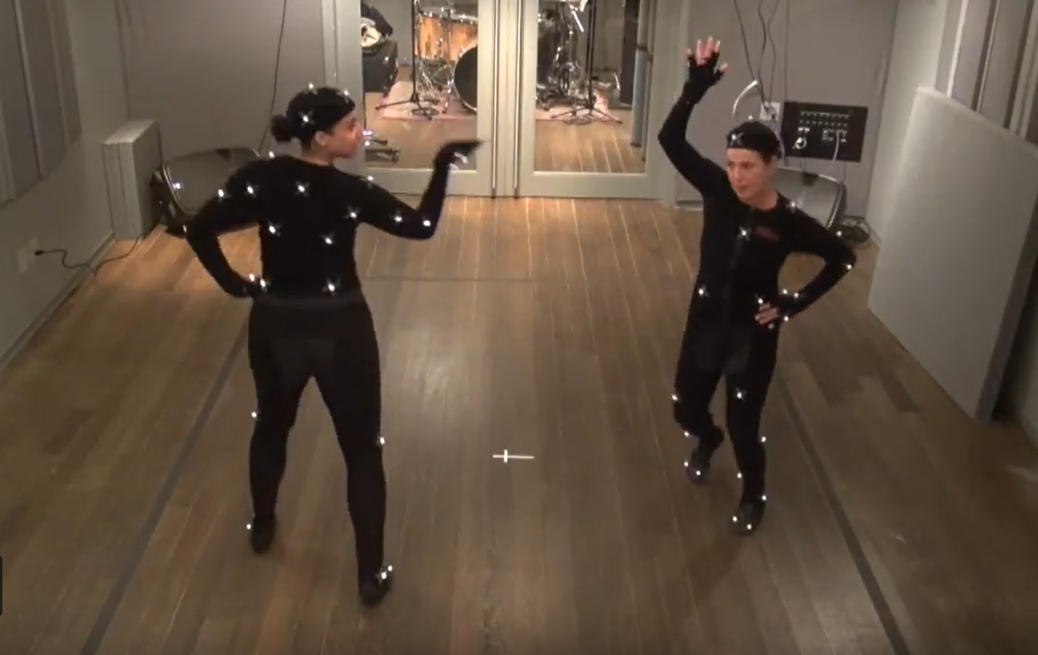
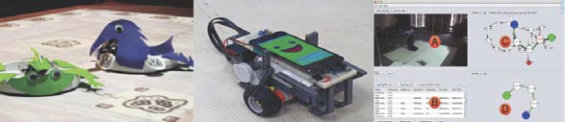
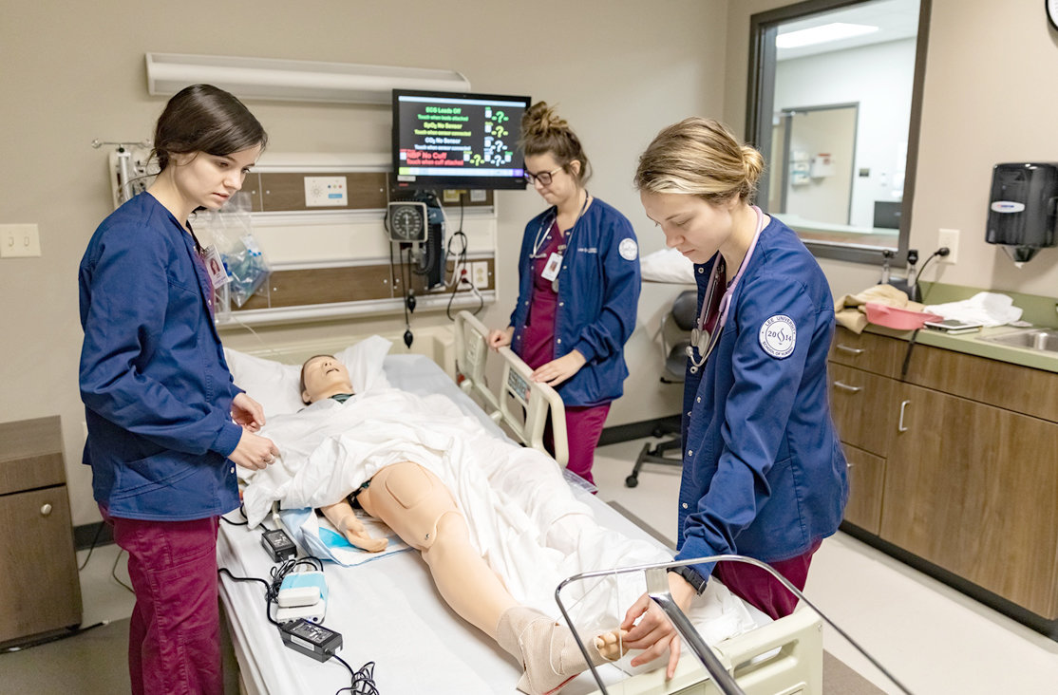
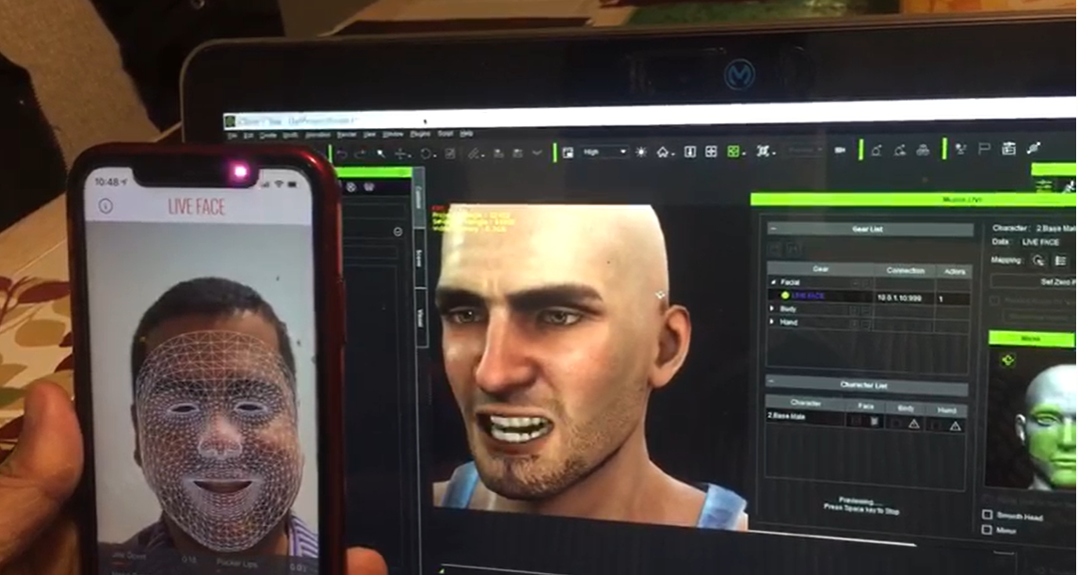
Projects / Possibilities / Problems

Slide 4
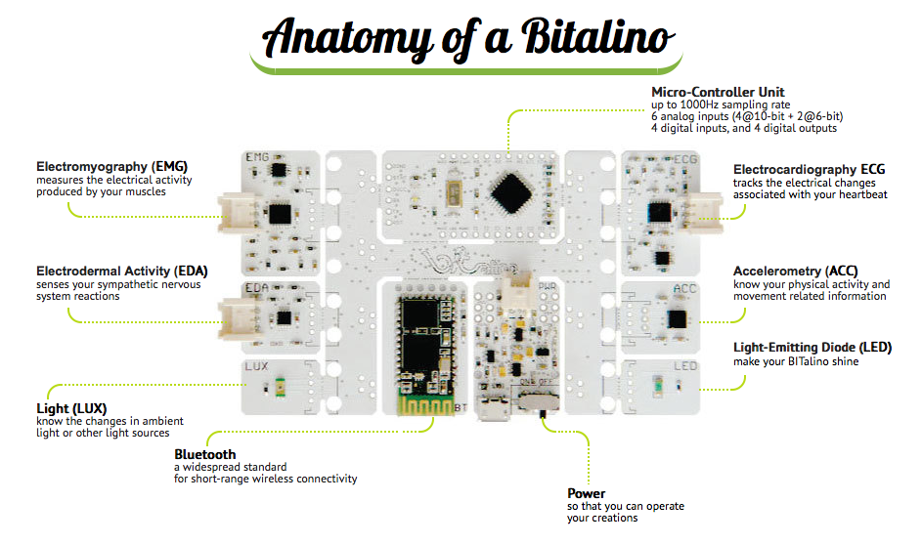
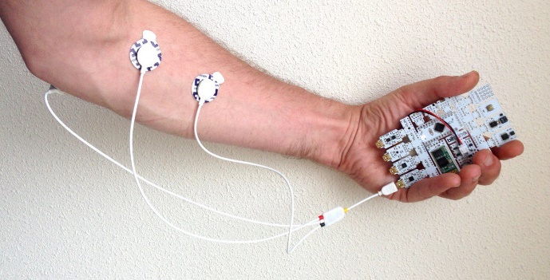
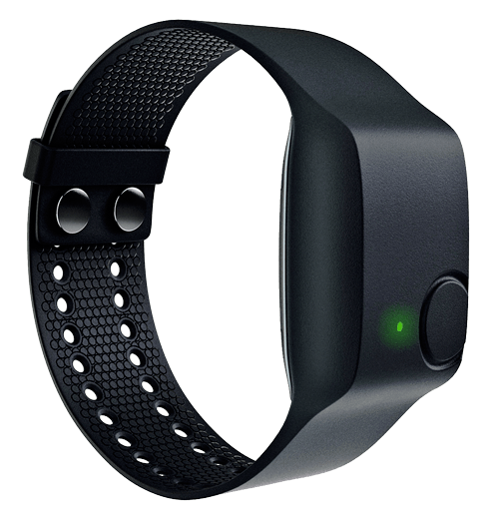
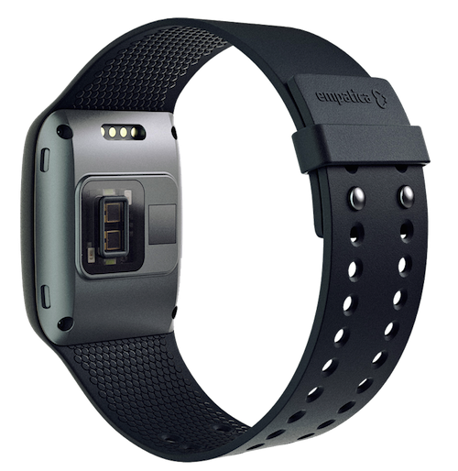
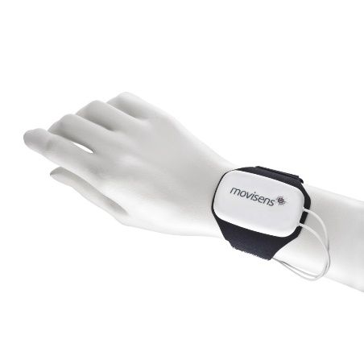
Wearable Devices / Open Data Protocols

Slide 5
10 Simple Rules in Practice
Define the workshop vision and goals
Ensure the sessions are not “containers”
Communicate the learning objectives and their dependencies
Implement active learning sessions
Evaluate and teach to participants’ skill sets and expectations
Provide a cognitive walkthrough on a “fresh” computer with naïve users
Stick to the script
Take into account evaluations from previous years and hold a post-mortem analysis soon after a workshop

Slide 6
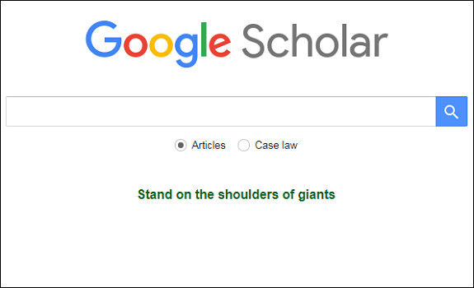
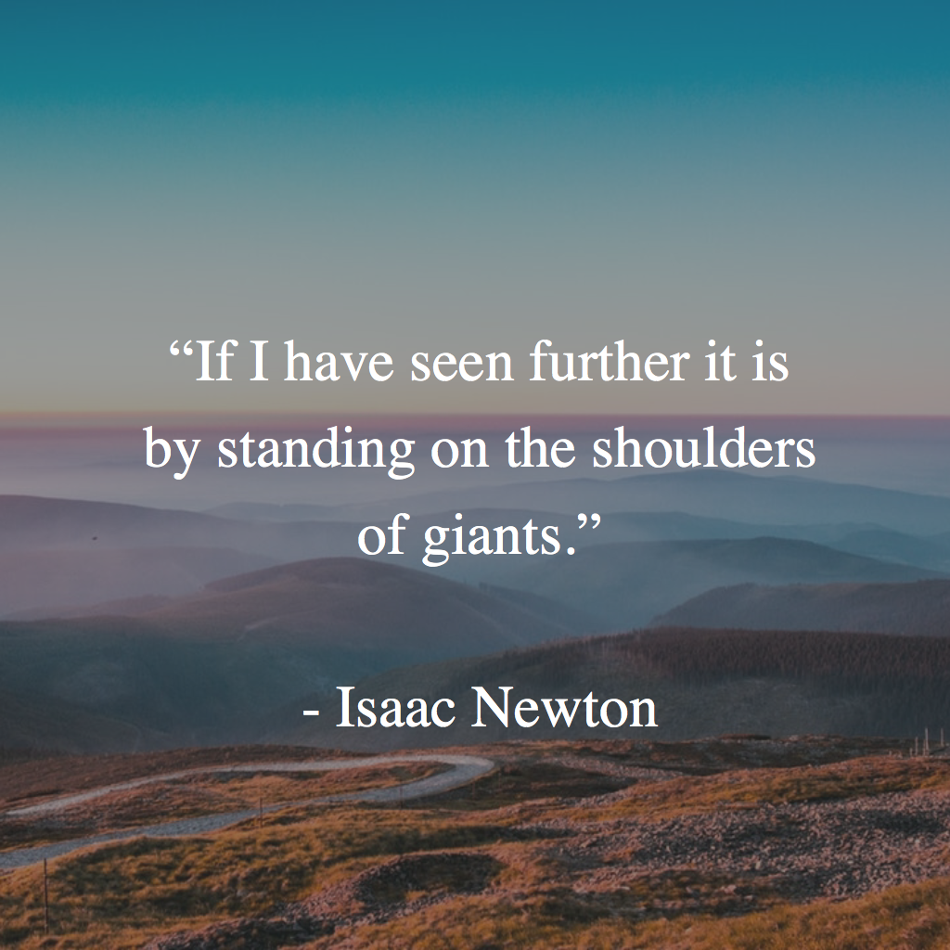
Sprint Preparation and Thanks

Slide 7
Define the workshop vision and goals
Day 1
Introductory Concepts
Sprint Presentation
Day 2
Intro to Computer Vision
Annotation
Day 3
Applied Object Classification
Object Detection
Day 4
Day 5
Cloud Services
Amazon and Google
Preparation for Project execuction
Readings

Slide 8
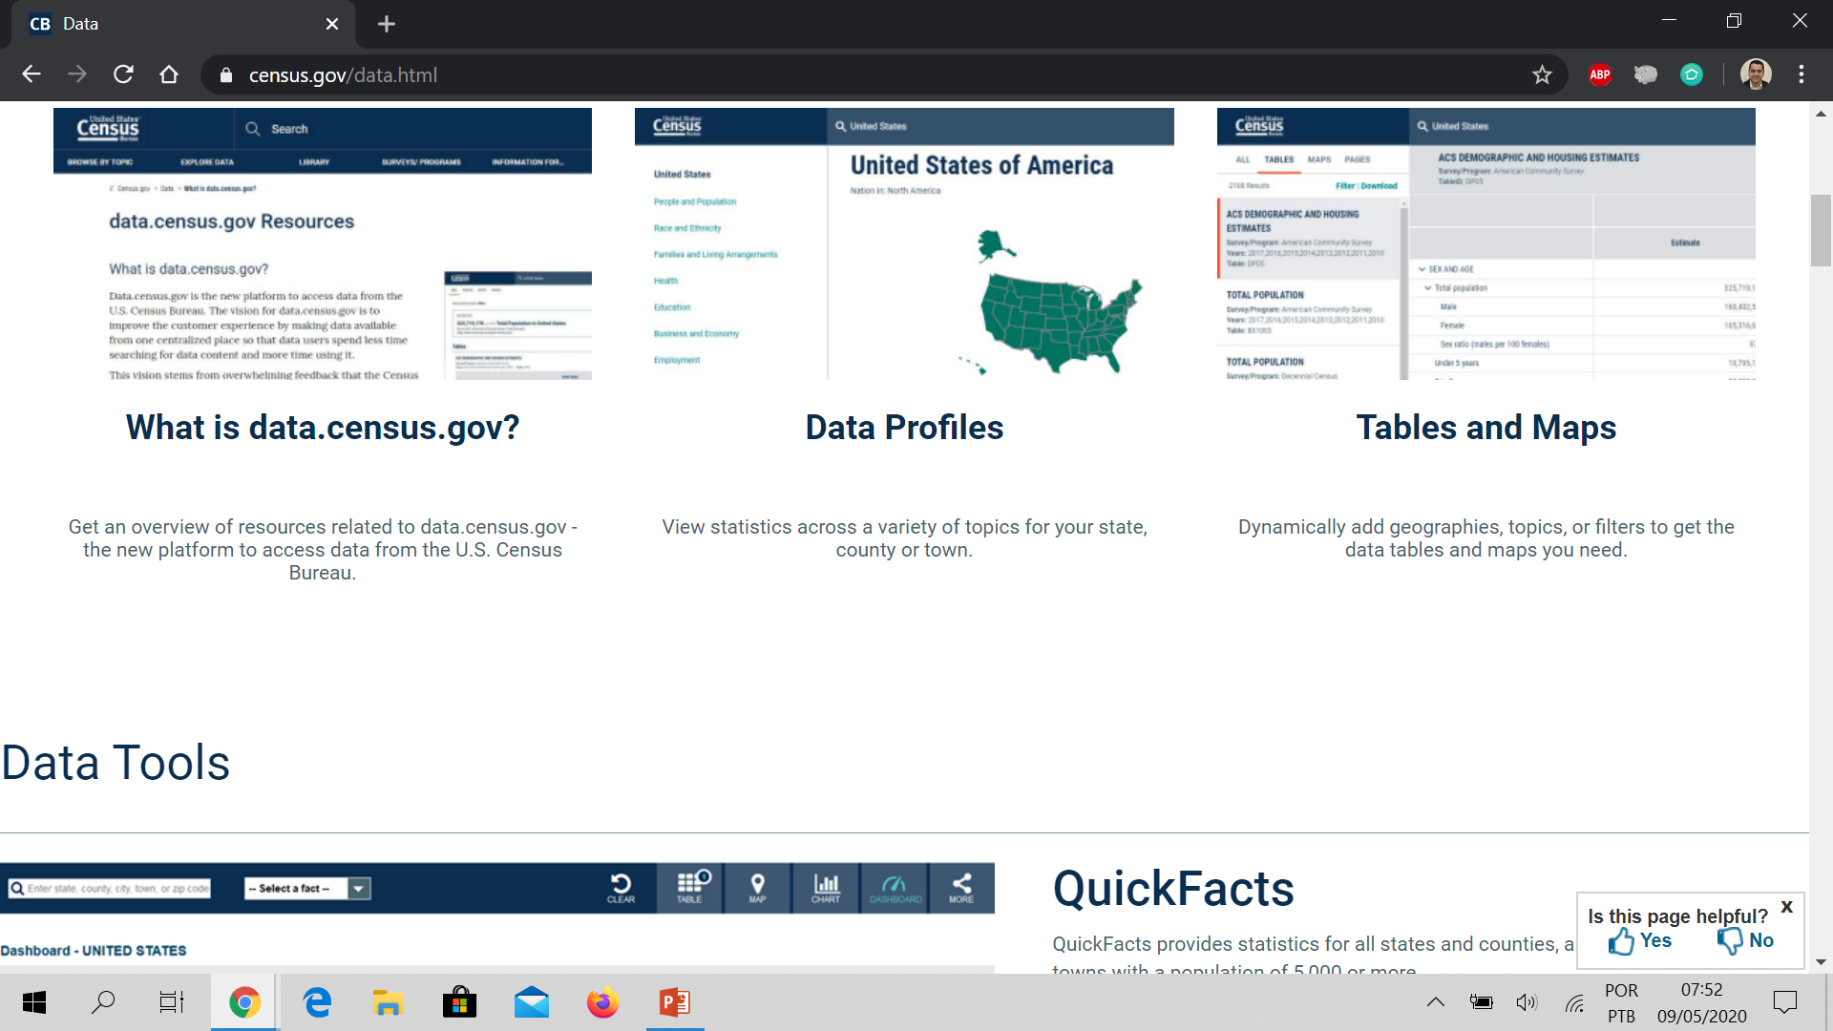
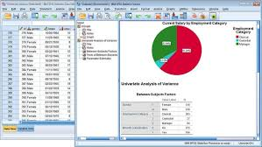


Census

Slide 9

Big Data
https://youtu.be/uPnfuczOWb8

Slide 10
Big Data Definitions – 3v, 5v, 6v, nV
Volume: Organizations collect data from a variety of sources, including business transactions, smart (IoT) devices, industrial equipment, videos, social media and more.
Velocity: With the growth in the Internet of Things, data streams in to businesses at an unprecedented speed and must be handled in a timely manner. RFID tags, sensors and smart meters are driving the need to deal with these torrents of data in near-real time.
Variety: Data comes in all types of formats – from structured, numeric data in traditional databases to unstructured text documents, emails, videos, audios, stock ticker data and financial transactions.
https://www.sas.com/en_us/insights/big-data/what-is-big-data.html
https://www.oracle.com/big-data/what-is-big-data.html

Slide 11
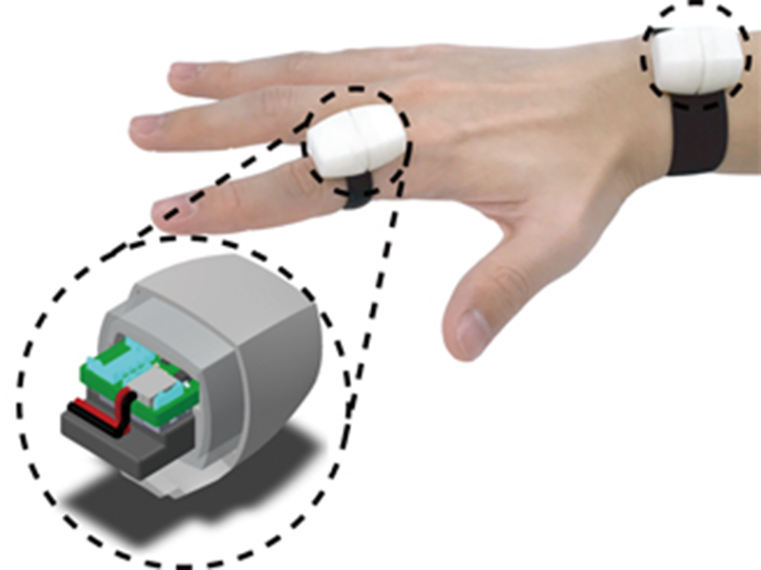
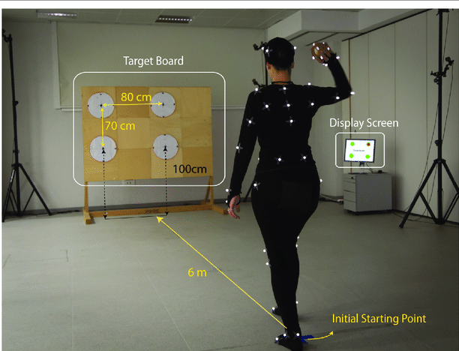
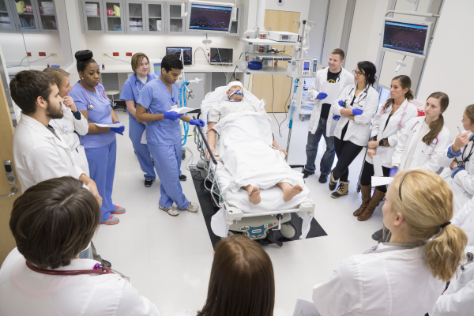
World Pre COVID-19

Slide 12
Today’s main points
Discuss the Sprint Challenge
Briefly present Arduino & Raspberry Pi Architectures
Use a Arduino Simulator
Introduce MQTT, review use cases and a conduct a simple producer subscriber implementation in Python with a run a free/open MQTT Broker and a Athmosphere Container
Test a RabbitMQ Simulator
Implement Queues and Exchanges in RabbitMQ – discuss differences

Slide 13
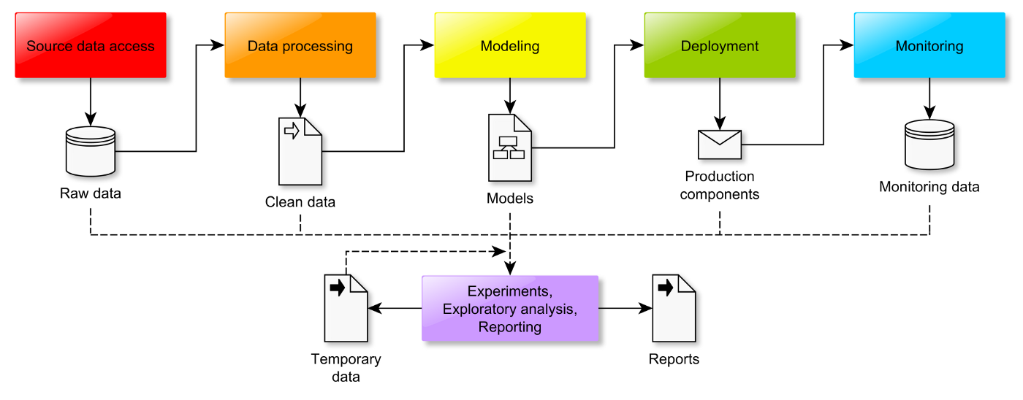
Data Science Workflow – Model
https://towardsdatascience.com/the-data-science-workflow-43859db0415

Slide 14
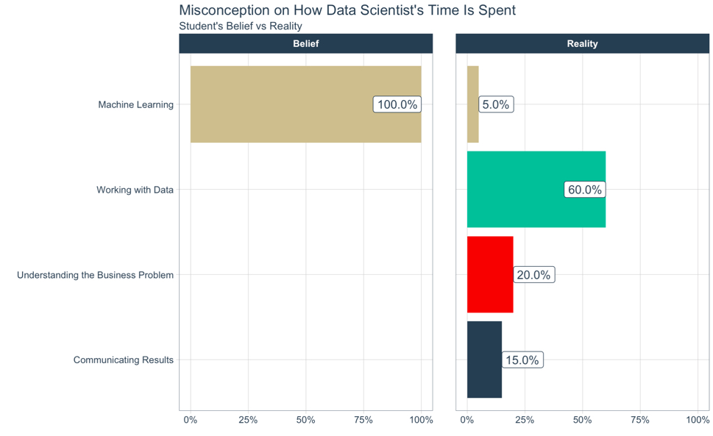
Time Spent with Data
People excited about data science see it as machine learning - 100% of the time (this is drastically disproportionate to reality). In reality, Machine Learning (or Modeling) is about 5% of your time. The rest of the time is spent:
Understanding the Business Problem: Communicating with Domain Experts (20%)
Working with Data: Cleaning, Manipulating, Visualizing, Processing, Transforming, and Understanding (60%)
Communicating Results: Reporting, Slide Decking, and Building Distributed Applications (Predictive Decision-Making Tools) (15%)
https://www.business-science.io/business/2019/06/27/data-science-workflow.html

Slide 15
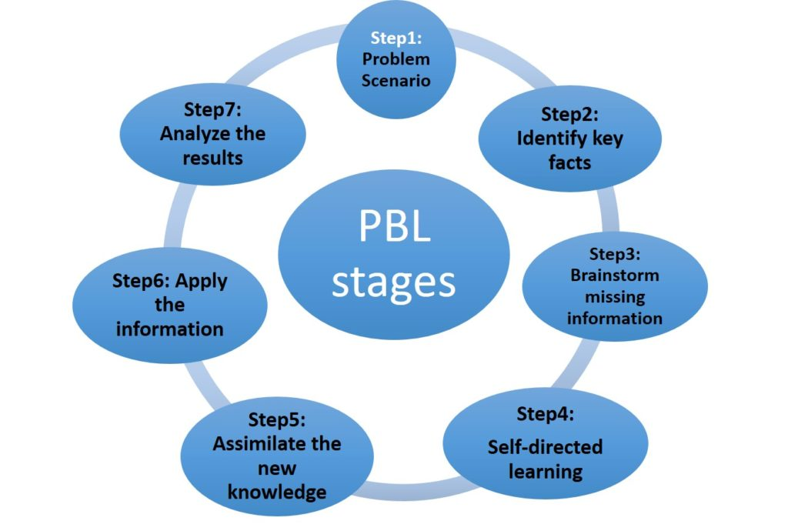
PBL
In PBL, class activities are constructed around a problem or problems.
The instructor is not the authoritative source of information and knowledge. Students have to take the initiatives to inquire and learn; and the instructor must guide, probe and support students' initiatives. What students learn during their self-directed learning must be applied back to the problem with reanalysis and resolution.
http://www.personal.psu.edu/wxh139/PBL.htm

Slide 16
Vision Impairment in U.S.
Nearly 1.3 million Americans age 40 and older are legally blind.^{[11]} More than 2.9 million Americans age 40 and older have low vision.^{[12]} Nearly 4.2 million Americans age 40 and older are visually impaired.^{[13]} (Defined as best-corrected visual acuity worse than 20/40 in the better-seeing eye; this number includes both those with low vision and those who are legally blind.)
https://www.aao.org/newsroom/eye-health-statistics
2017 National Health Interview Survey (NHIS) data release established that an estimated 26.9 million adult Americans (or about 10% of all adult Americans) reported they either "have trouble" seeing, even when wearing glasses or contact lenses, or that they are blind or unable to see at all.

Slide 17
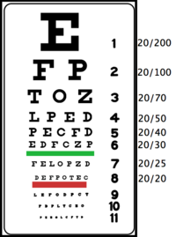
Visual Acuity and Low Vision
Visual acuity is a number that indicates the sharpness or clarity of vision. A visual acuity measurement of 20/70 means that a person with 20/70 vision who is 20 feet from an eye chart sees what a person with unimpaired (or 20/20) vision can see from 70 feet away.
If you can read line 8 (D E F P O T E C) from 20 feet away while wearing your regular glasses or contact lenses, the doctor records your vision (or visual acuity) as 20/20 with best correction.

Slide 18
Project – Problem Scenario
We implement the system on common hardwares (including Nvidia Jetson Box Tx2, Zed Camera, Ardurino Controller Board and Headset) and conducted experiments with groups of VI (performed by volunteers) in real environment to demonstrate its effectiveness and robustness.

Slide 19
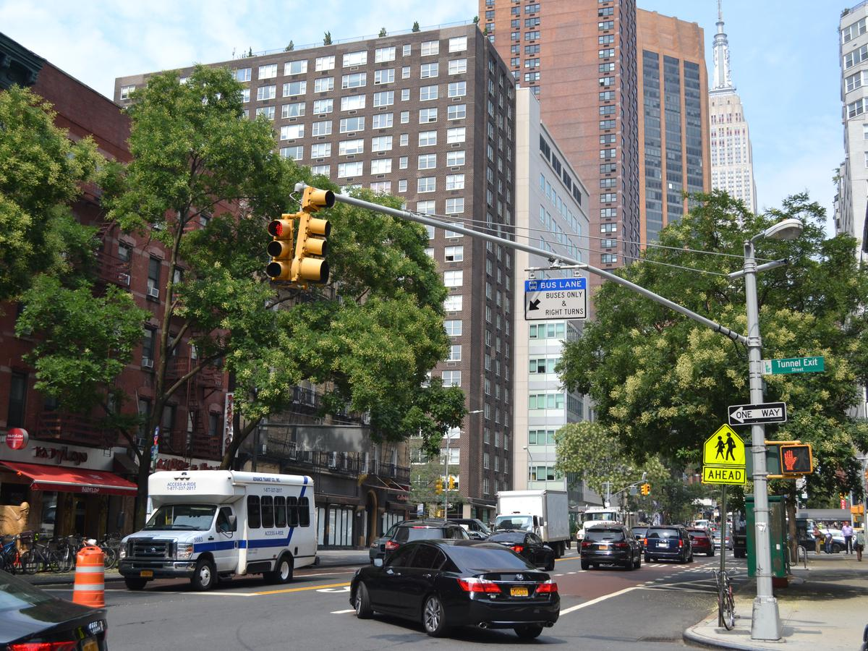
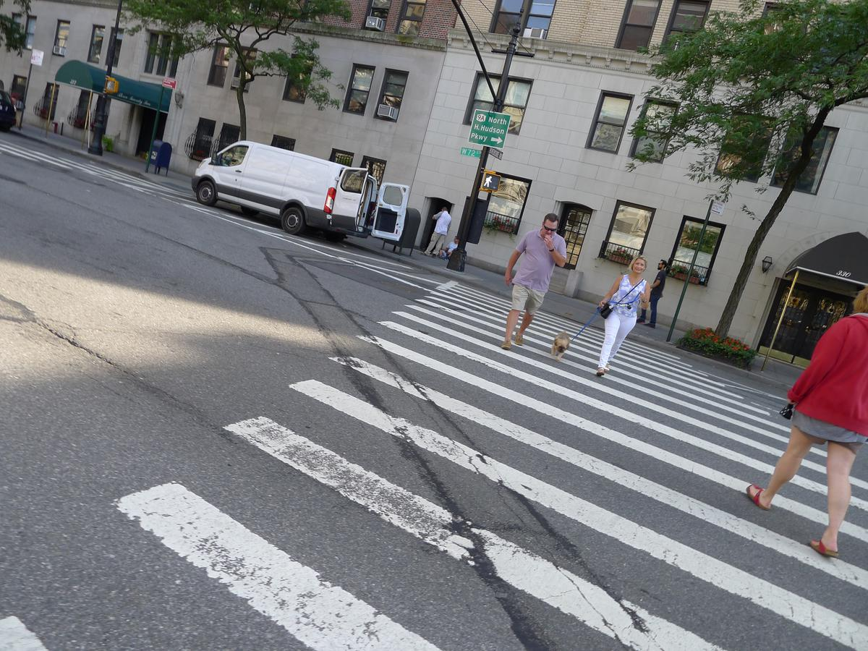
Project Information
Implement a Image Recognition Pipeline – with 12 k images of NYC Pedestrian Lights
Context: Collaboration NYU – UA Prof. J.R. Rizzo/ Prof. Win Burleson
Explore Diferent Models including cloud based, local deployment and “on the edge” inference. Understand the diferences of models, including performance, limitations and cost

Slide 20
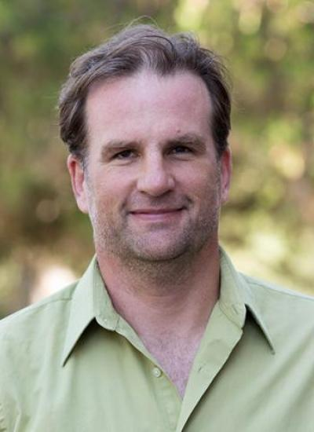
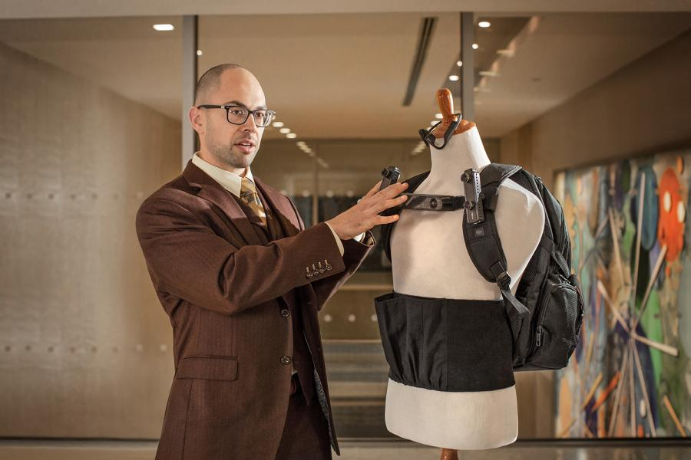
Stakeholders
John-Ross (JR) Rizzo, M.D., M.S.C.I., is an American physician-scientist at NYU Langone Medical Center. He leads the REACTIV Laboratory (Rehabilitation Engineering Alliance and Center Transforming Low Vision), where his team focuses on advanced wearables for the sensory deprived and benefits from his own personal experiences with vision loss.
Dr. Winslow Burleson is a social inventor, a scholar, researcher, artist, and educator with expertise in Human Computer Interaction and the Learning Sciences. He has been recognized as a Distinguished Member of the Association for Computing Machinery, a pioneering innovator advancing the digital age.
https://en.wikipedia.org/wiki/John-Ross_Rizzo

Slide 21
Project Structure
Two TEAMS: Randomly assigned (TBD)
One will team explore the comercially available solutions – Day 4
One team will explore the feasibility of running a in-house solution
Both situations should envision the possibility of implementation of the models in the edge using devices such as raspberry pi, Nvidia or Google TPU’s.

Slide 22


Deliverables
SCOPE
Train Models with the dataset
Present performance and other indicators
Early evaluation of feasibility, challenges and costs if applicable
NOT SCOPE
Develop a full-blown system
Deliver a optimized model
Implement the model in real time
Final recommendation

Slide 23
Sprint - Reading List
1 - An assistive low-vision platform that augments spatial cognition through proprioceptive guidance: Point-to-Tell-and-Touch
2 - A Wearable Assistive Technology for the Visually Impaired with Door Knob Detection and Real-Time Feedback for Hand-to-Handle Manipulation
3 - A Survey of Deep Learning-based Object Detection
4 - Convergence of Edge Computing and Deep Learning: A Comprehensive Survey

Slide 24
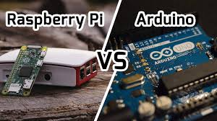
Raspberry Pi vs Arduino
An Arduino is a microcontroller motherboard. A microcontroller is a simple computer that can run one program at a time, over and over again. It is very easy to use.
A Raspberry Pi is a general-purpose computer, usually with a Linux operating system, and the ability to run multiple programs. It is more complicated to use than an Arduino

Slide 25
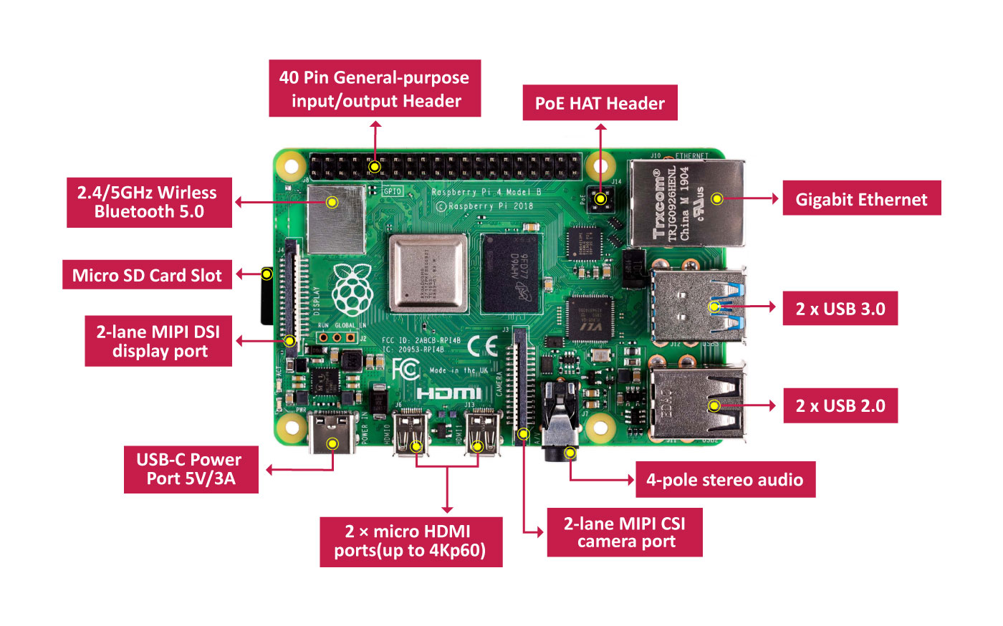
Raspberry Pi 4
Broadcom BCM2711, quad-core Cortex-A72 (ARM v8) 64-bit SoC @ 1.5GHz
Up to 4Gb
GPIO: Standard 40-pin GPIO header(fully backward-compatible with previous boards)

Slide 26
Best Rule of Thumb ever
Is there a simple rule of thumb to help me decide?
Yes, there is! Think about what you want your project to do. If you can describe it with less than two ‘and’s, get an Arduino. If you need more than two ‘and’s, get a Raspberry Pi.
“I want to monitor my plants and have them Tweet me when they need water.” That can best be done by an Arduino.
“I want to monitor my plants and have them Tweet me when they need water and check the National Weather Service, and if the forecast is for fair weather, turn on the irrigation system and if the forecast is for rain, do nothing.” That would best be handled by a Raspberry Pi
https://makezine.com/2015/12/04/admittedly-simplistic-guide-raspberry-pi-vs-arduino/
https://www.electronicshub.org/raspberry-pi-vs-arduino/

Slide 27
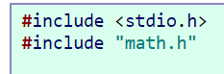
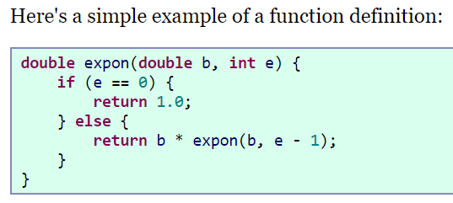
5 min – C for Python Programmers
An important point with respect to arrays: What happens if you access an array index outside the array, like accessing pops[50] or pops[-100]?
With Python or Java, this will terminate the program with a friendly message pointing to the line at fault and saying that the program went beyond the array bounds. C is not nearly so friendly.
http://www.toves.org/books/cpy/

Slide 28
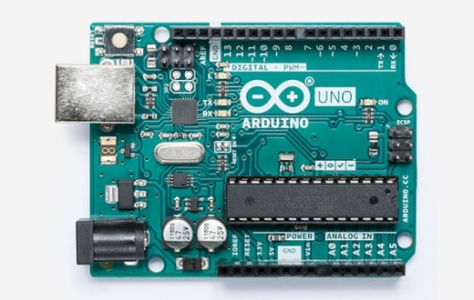
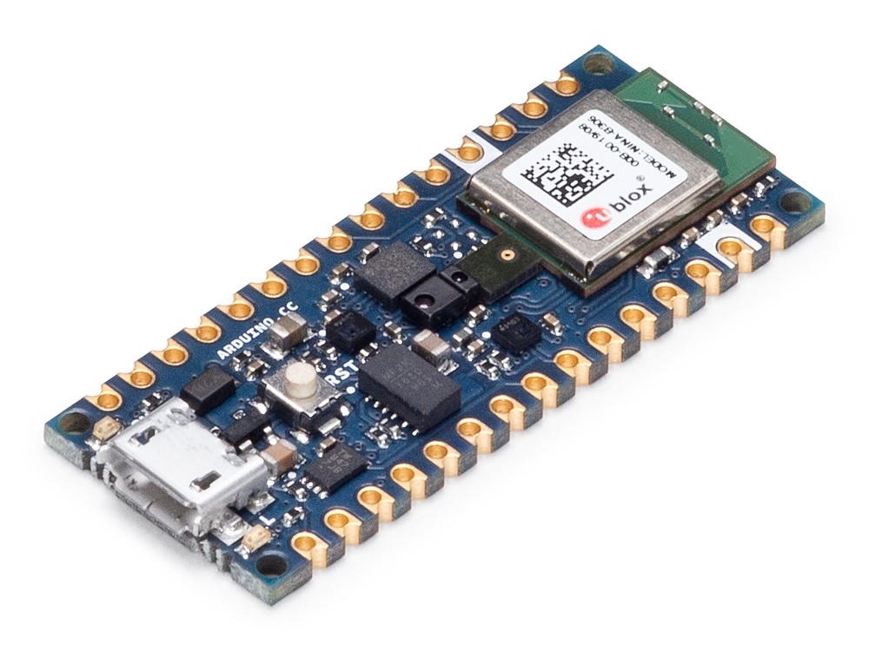
Arduino – Different Models and Applications
Arduino Nano 33 BLE Sense - 9 axis inertial sensor, humidity, and temperature sensor. barometric sensor, microphone
https://www.arduino.cc/en/main/products

Slide 29
Intro to Micro Controllers Functions: setup(), loop() and Custom
void setup () { }; - tells the Arduino that whatever is in this function must be run once before the Arduino starts the main computation loop.
void loop () { }; - the second function that must be in every Arduino program is called loop. This function executes once every clock cycle (at 16 MHz)
Custom functions typically take a number of arguments (inputs) and return a single output
double average(double first_val, double second_val, double third_val) {
double result = (first_val + second_val + third_val) / 3;
return result;
};

Slide 30
Intro to Micro controllers
The Arduino is capable of communicating using serial communications and we can send simple ASCII text to and from the Arduino.
Serial.begin(9600);
Pin #13 on the Arduino is wired in parallel to a small LED on the board. pinMode() is used to set mode of pin number 13 to OUTPUT
int led_pin_num = 13;
void setup() {
pinMode(led_pin_num, OUTPUT);
};
We can make this LED blink by utilizing the builtin digitalWrite() function.
void loop() {
digitalWrite(led_pin_num, HIGH);
delay(100);
digitalWrite(led_pin_num, LOW);
delay(100);
};
https://moorepants.github.io/eme185/pages/part-1-intro-to-microcontrollers-with-emulation.html

Slide 31
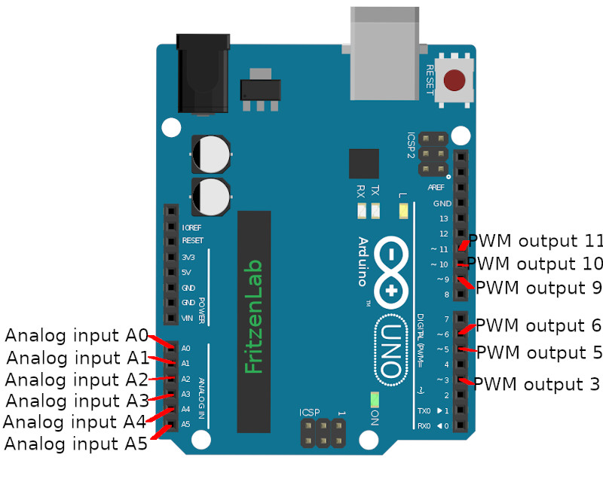
Intro to MicroControllers
There are six analog input pins on the Arduino Uno.
Sources that supply continuous voltage from 0 to 5 volts can be read using these pins.
int val = analogRead(pin_num);
The on-board analog to digital converter has 10 bit resolution, i.e. 2^10 = 1024 possible readings. The values 0 to 1023 are mapped to 0 to 5 volts, i.e. .0049 volts per step.
analogRead(pin_num) - Writes an analog value (PWM wave) to a pin. Can be used to light a LED at varying brightnesses or drive a motor at various speeds.

Slide 32
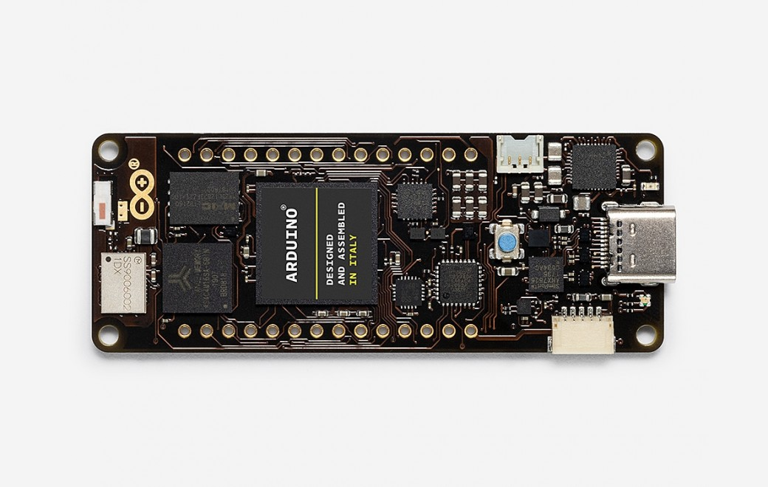
New Trends
PORTENTA H7
The Portenta H7 will be ready for shipment approximately at the end of May 2020.
Program it with high-level languages and AI while performing low-latency operations on its customizable hardware. Portenta can easily run processes created with TensorFlow™ Lite, you could have one of the cores computing a computer vision algorithm on the fly, while the other could be making low-level operations like controlling a motor, or acting as a user interface.

Slide 33
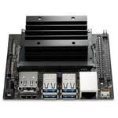
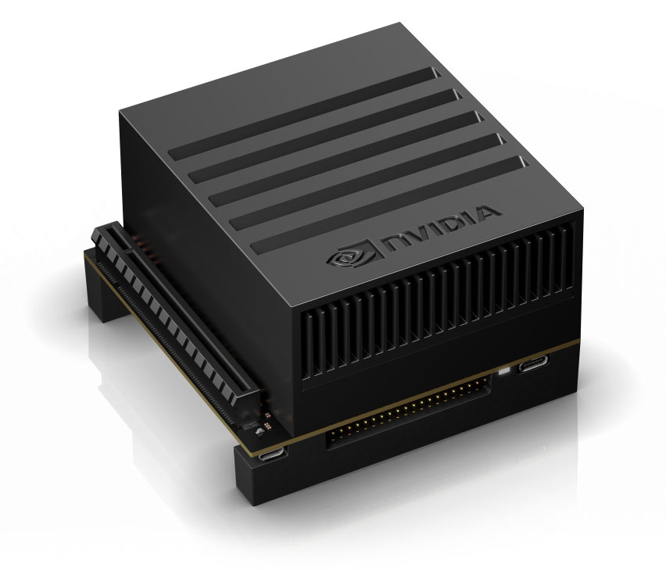
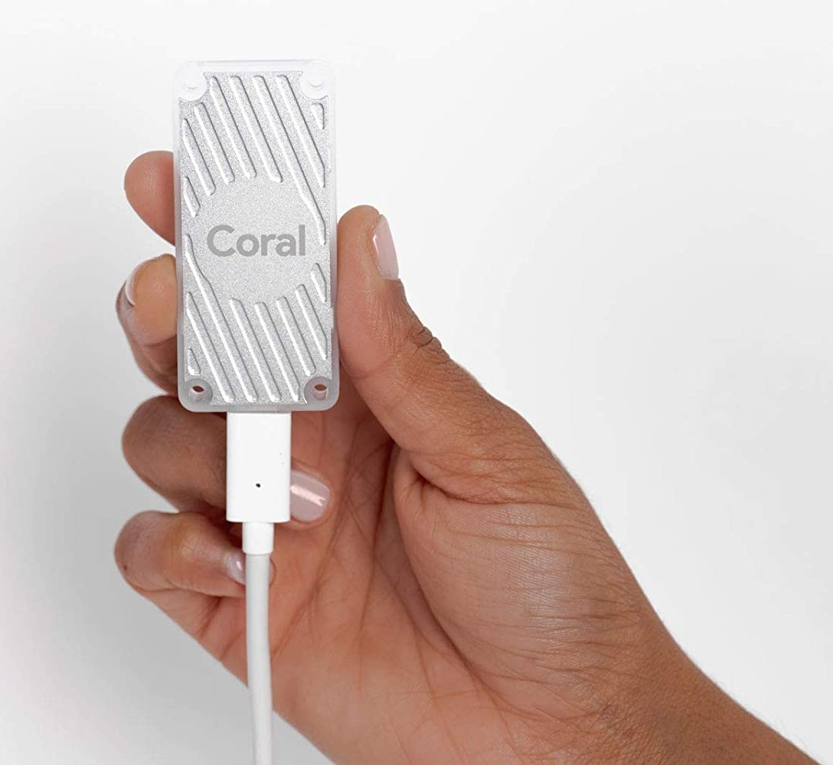
New Trends
Nvidia Jetson Nano
Nvidia AGX Xavier
Google TPU – USB version

Slide 34
Simulator Time
Tinkercad is a free, online 3D modeling program that runs in a web browser, known for its simplicity and ease of use.
https://www.tinkercad.com
https://www.tinkercad.com/things/gQyRQ9PcXmq-copy-of-arduino-digital-and-analog-inputs-to-serial-monitor
https://www.tinkercad.com/things/61uiTRYDLVk-arduino-datalogger-simple
https://www.instructables.com/id/Arduino-Datalogger/

Slide 35


Setup for Server – Day 1

Slide 36
MQTT Protocol
What is MQTT?
MQTT is a lightweight publish/subscribe messaging protocol designed for M2M (machine to machine) telemetry in low bandwidth environments.
For MQTTv3.1.1 there is client software available in almost all programming languages and for the main operating systems Linux, Windows, Mac from the Eclipse Paho project
http://www.steves-internet-guide.com/mqtt/

Slide 37
Publisher/Subscriber Model
Publish/subscribe messaging, or pub/sub messaging, is a form of asynchronous service-to-service communication used in serverless and microservices architectures. In a pub/sub model, any message published to a topic is immediately received by all of the subscribers to the topic.
Pub/sub messaging can be used to enable event-driven architectures, or to decouple applications in order to increase performance, reliability and scalability.
https://aws.amazon.com/pub-sub-messaging/

Slide 38
Four Core Concepts
Topic – An intermediary channel that maintains a list of subscribers to relay messages to that are received from publishers
Message – Serialized messages sent to a topic by a publisher which has no knowledge of the subscribers
Publisher – The application that publishes a message to a topic
Subscriber – An application that registers itself with the desired topic in order to receive the appropriate message

Slide 39
Common use cases
Balancing workloads in network clusters. For example, a large queue of tasks can be efficiently distributed among multiple workers, such as Google Compute Engine instances.
Implementing asynchronous workflows. For example, an order processing application can place an order on a topic, from which it can be processed by one or more workers.
Refreshing distributed caches. For example, an application can publish invalidation events to update the IDs of objects that have changed.
Data streaming from various processes or devices. For example, a residential sensor can stream data to backend servers hosted in the cloud.
Reliability improvement. For example, a single-zone Compute Engine service can operate in additional zones by subscribing to a common topic, to recover from failures in a zone or region.
https://cloud.google.com/pubsub/docs/overview

Slide 40
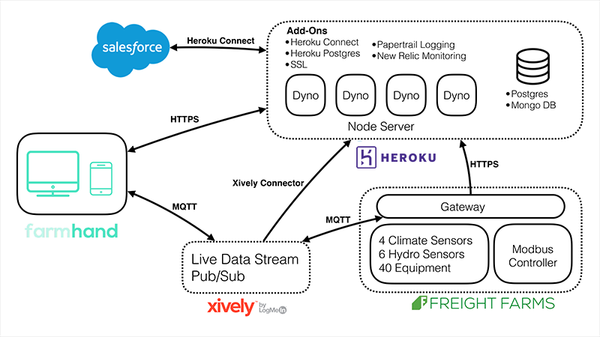
Sample Case: Freight Farms
Powering the real food revolution with IoT, MQTT. Every farm is provisioned with a gateway device that’s running a Xively MQTT client locally. It’s connected to the other hardware devices, such as IP security cameras, wireless sensors, and the farm’s automation controller. Xively serves as our MQTT communication gateway and broker.

Slide 41
Sample Case Specifics
With MQTT, you have one broker and n number of clients. Each new message only needs to be sent over the wire from the farm once, but will end up on all connected clients and our server instantly. This both saves on bandwidth and scales well as we bring more farms and client apps online.
MQTT is built around the concept of channels (ex. /sensors), and each client can subscribe to and extend channels (ex. /sensors/{farmId}). They don’t just have a /sensor channel that every device or client can subscribe to. Instead, every farm has its own set of channels built from the template, e.g. /{farmId}/sensors.
Each farm has 10 sensors. Some track climate-related conditions, such as humidity, CO2, and temperature. Others track conditions in our growing tanks, such as nutrients or pH levels in the water.

Slide 42
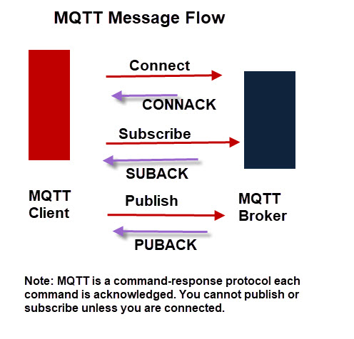
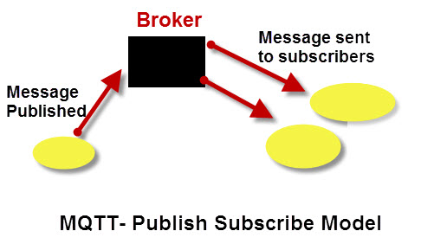
MQTT – 101
http://www.steves-internet-guide.com/mqtt-works/

Slide 43
MQTT Paho - Callbacks
on_connect() - Called when the broker responds to our connection request
on_disconnect() - Called when the client disconnects from the broker
on_message() – Called when a message has been received on a topic that the client subscribes to and the message does not match an existing topic filter callback.
message_callback_add() - This function allows you to define callbacks that handle incoming messages for specific subscription filters, including with wildcards. This lets you, for example, subscribe to sensors/# and have one callback to handle sensors/temperature and another to handle sensors/humidity.
on_publish() - Called when a message that was to be sent using the publish() call has completed transmission to the broker.
https://www.eclipse.org/paho/clients/python/docs/

Slide 44
Launch the Jupyter NB
Walkthough the code
Send / Receive in Different Computers/Notebooks
Devise a schema for “sensor” data
Time estimated – 15 minutes
http://www.steves-internet-guide.com/understanding-mqtt-topics/

Slide 45
RabbitMQ - AMQP
RabbitMQ is a distributed message queue system. Distributed because it is usually run as a cluster of nodes where queues are spread across the nodes and optionally replicated for fault tolerance and high availability.
RabbitMQ takes both a classic and a novel take on messaging. Classic in the sense that it is oriented around message queues, and novel in its highly flexible routing capability.
https://www.youtube.com/watch?v=deG25y_r6OY

Slide 46
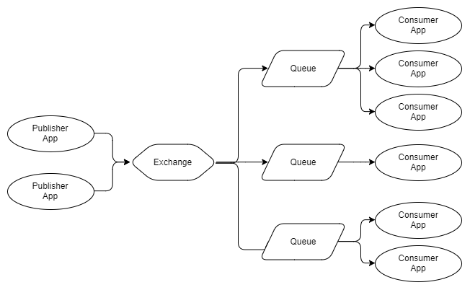
Main Concepts

Slide 47
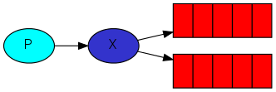
Exchanges
A producer is a user application that sends messages.
A queue is a buffer that stores messages.
A consumer is a user application that receives messages.
There are a few exchange types available: direct, topic, headers and fanout.
The core idea in the messaging model in RabbitMQ is that the producer never sends any messages directly to a queue. Actually, quite often the producer doesn't even know if a message will be delivered to any queue at all.

Slide 48
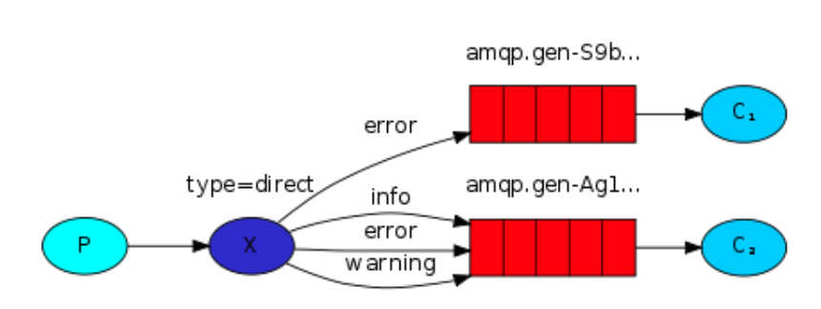
Routing Messages - RabbitMQ
It is possible to subscribe only to a subset of the messages. For example, we will be able to direct only critical error messages to the log file (to save disk space), while still being able to print all of the log messages on the console.
A binding is a relationship between an exchange and a queue. This can be simply read as: the queue is interested in messages from this exchange.
channel.queue_bind(exchange=exchange_name, queue=queue_name, routing_key='black')

Slide 49
Rabbitmq Simulator
http://tryrabbitmq.com/

Slide 50
Main Tutorials
The simplest thing that does something (https://www.rabbitmq.com/tutorials/tutorial-one-python.html)
Distributing tasks among workers (the competing consumers pattern)
Sending messages to many consumers at once (https://www.rabbitmq.com/tutorials/tutorial-three-python.html)
https://www.rabbitmq.com/getstarted.html

Slide 51
Quick Feedback

